Slide 1
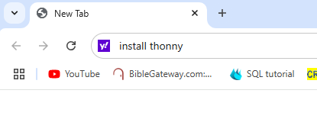
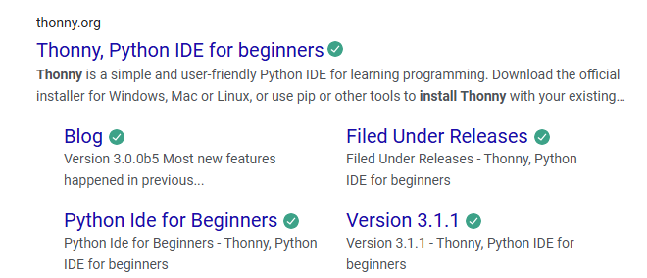
Learning Python without the Pico
1. Install Thonny on your PC

Slide 2
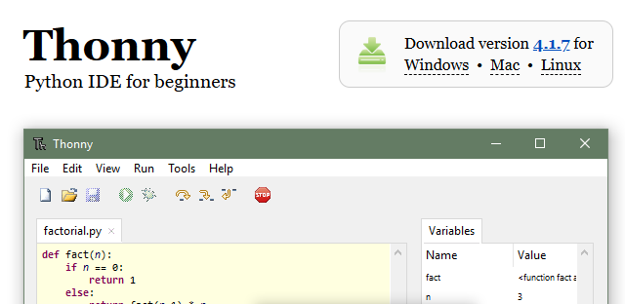
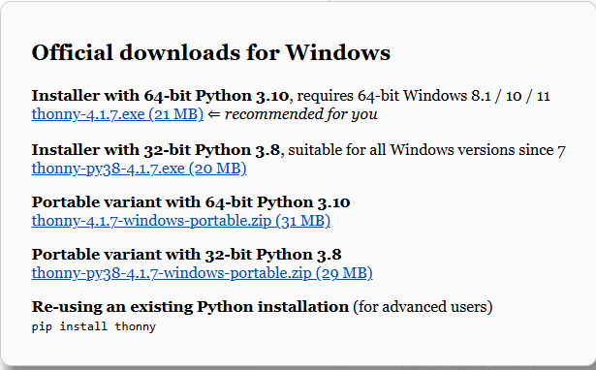
Choose either 64 bit or 32 bit

Slide 3
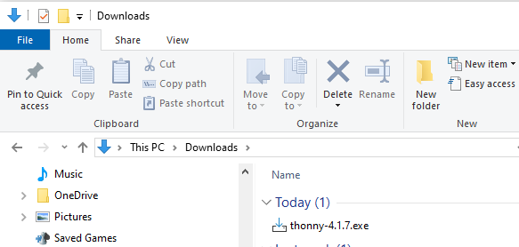
To install the software

Slide 4
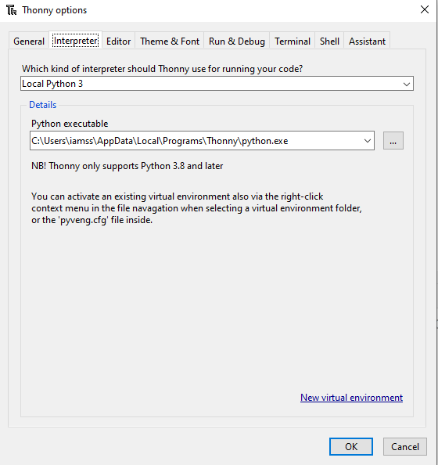

Launch Thonny on your PC

Slide 5
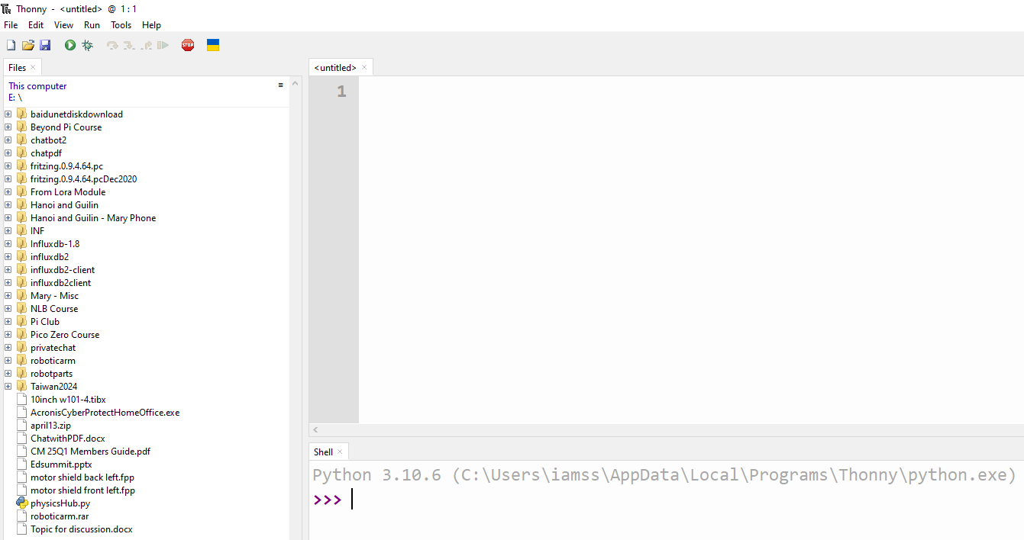

Slide 6
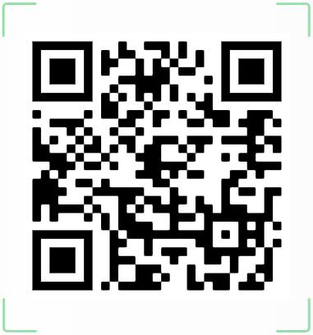
Download Thonny Installation Powerpoint Slides

Slide 7
Python Online Course
https://automatetheboringstuff.com/
https://www.w3schools.com/python/

